Slide 1
Cell Biology: Lecture 16
Cytoskeleton
Notes:
1

Slide 2
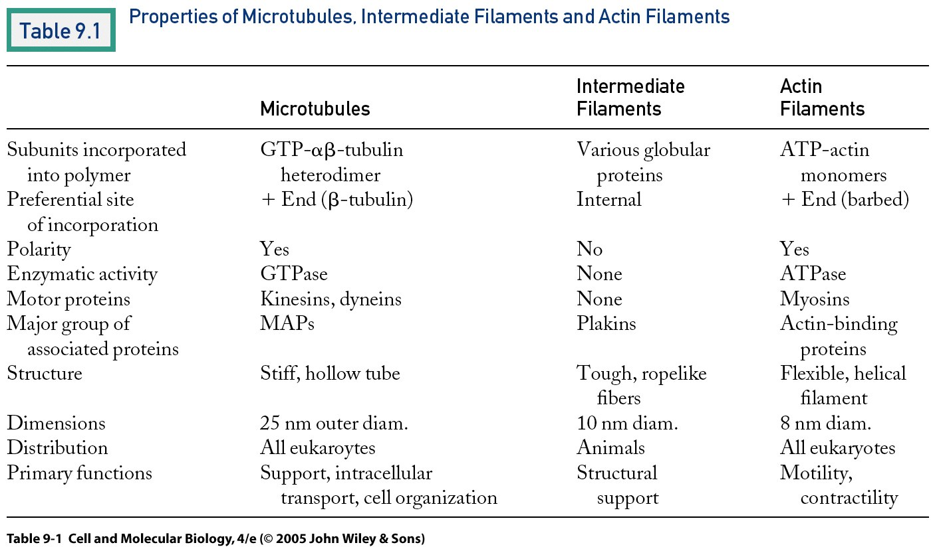
Notes:
2

Slide 3
Microtubules
Microtubules
I. Introduction: Long, hollow cylinders, 25 nm in diameter, made of tubulin. The basic subunit is a heterodimer of α and β tubulin (9.8); 13 protofilaments in a typical cylinder. See below about GTP binding, treadmilling, growth and dynamic instability (9.26). There is a + end, fast growing, w/β tubulin at its end, and a – end, slow growing, w/α tubulin at its end. The GTP’s are important in assembly
A. They have MAPs, that influence their use- linking them together, stabilizing them, or destabilizing them.
B. They form a network, coming from the microtubule organizing center, which is usually the centrosome or centriole, w/ the – end anchored there.
C. Also form cilia and flagella, and spindle fibers in mitosis.
Notes:
3

Slide 4
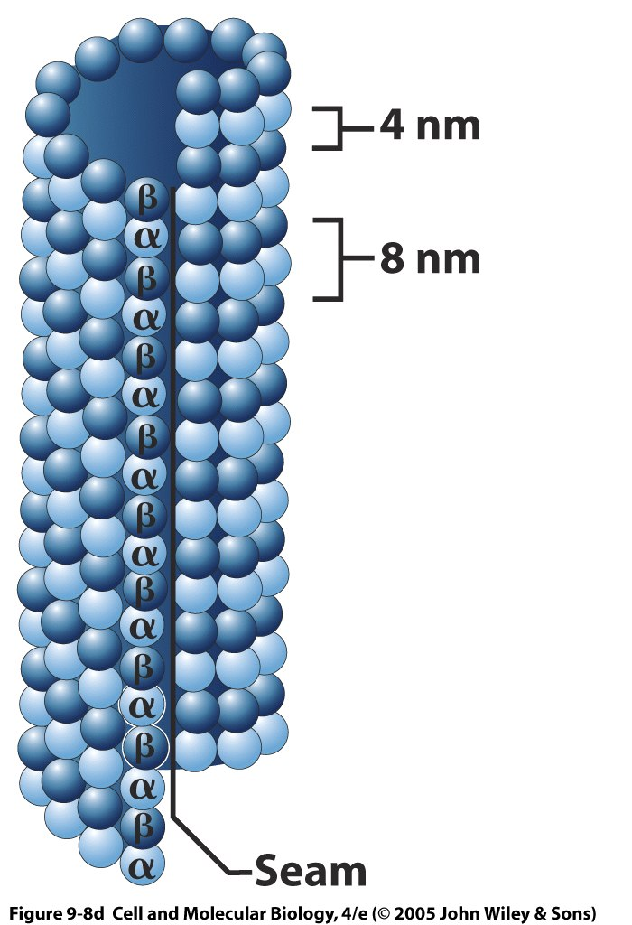

Slide 5
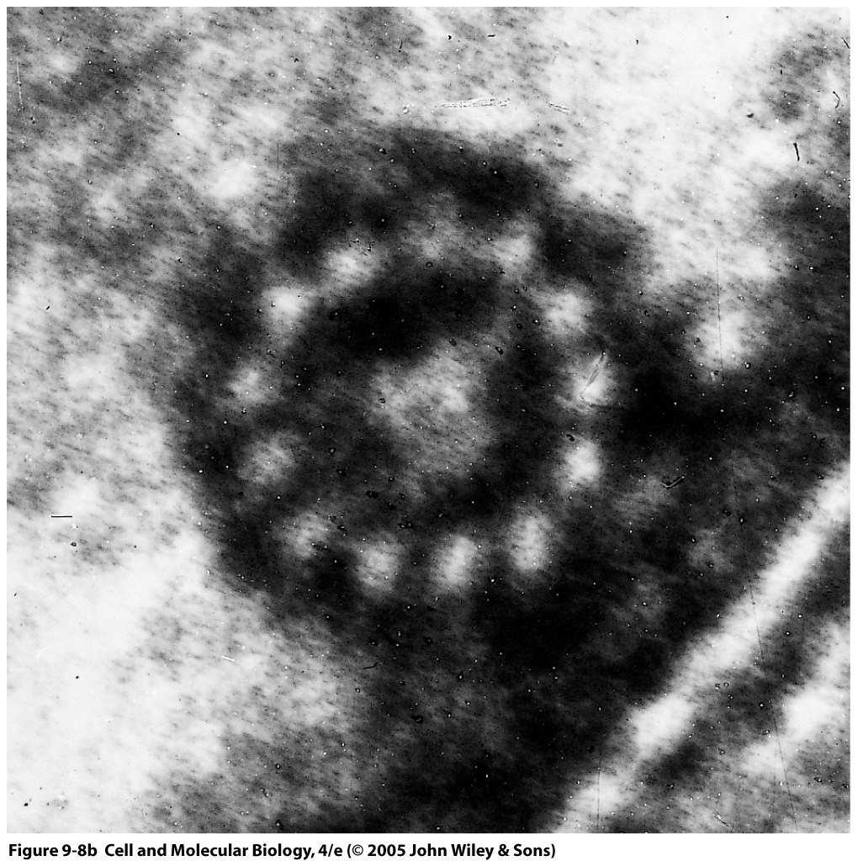
13 protofilaments

Slide 6
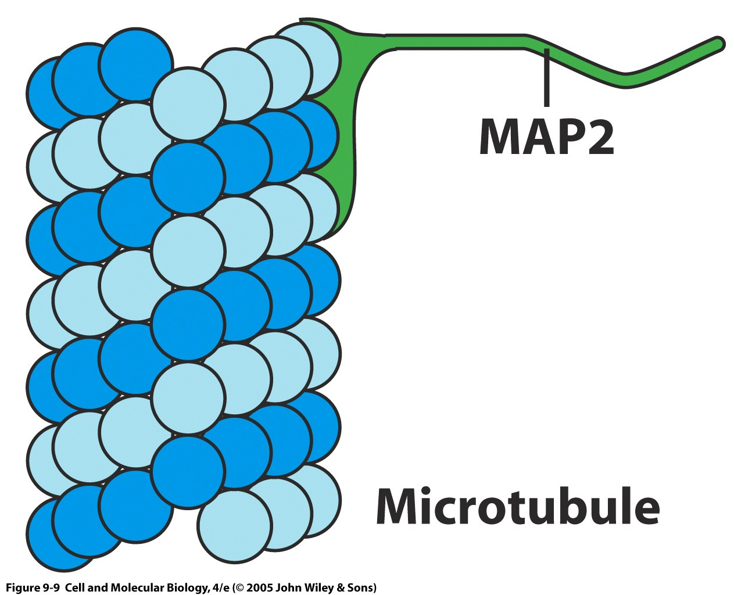

Slide 7
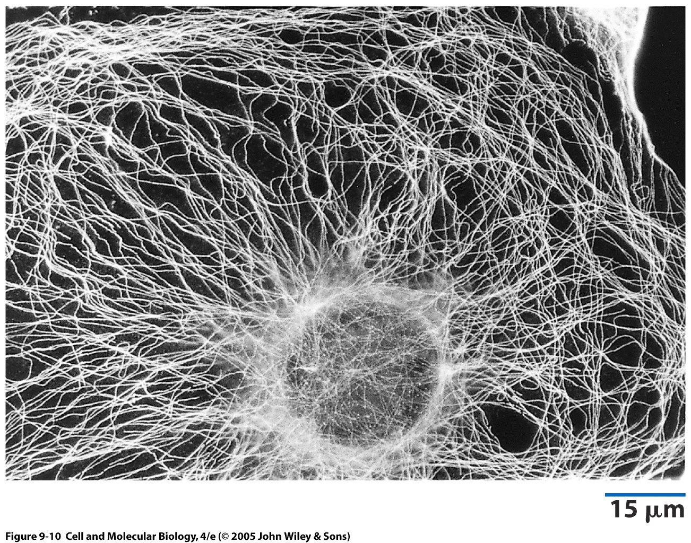

Slide 8
Nucleation
Gamma tubulin in MTOC/centriole- MT’s grow from there

Slide 9
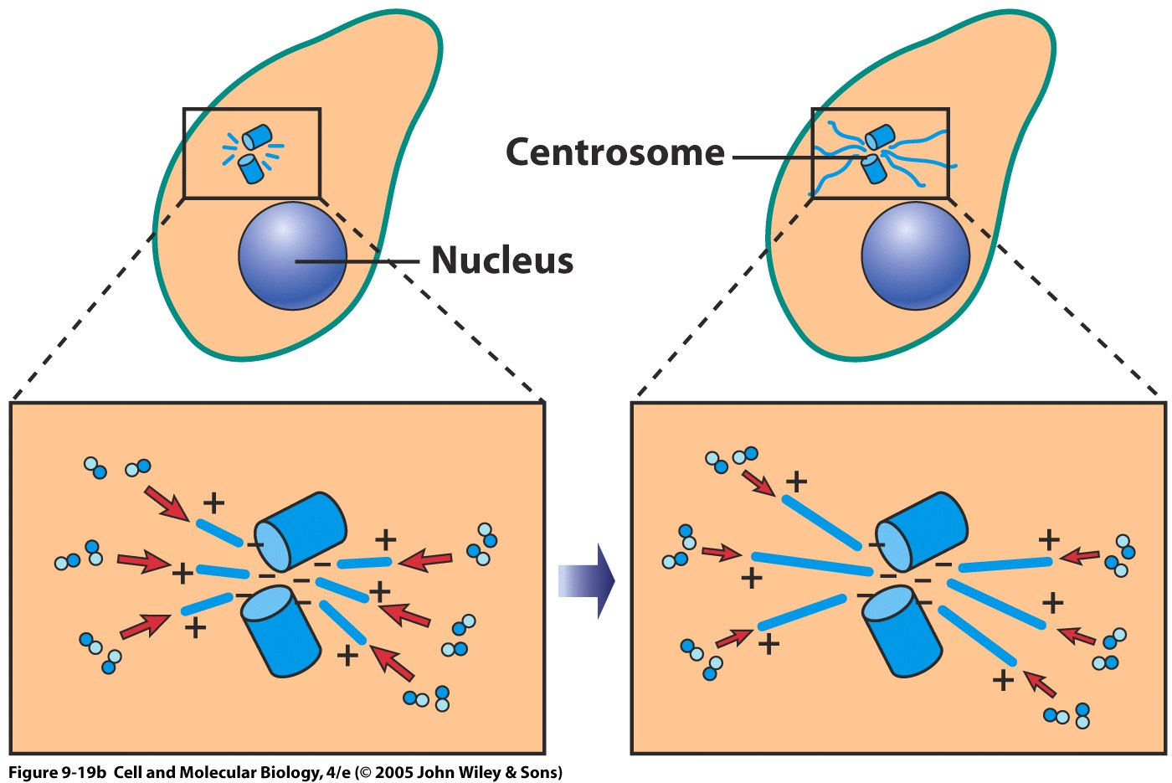

Slide 10
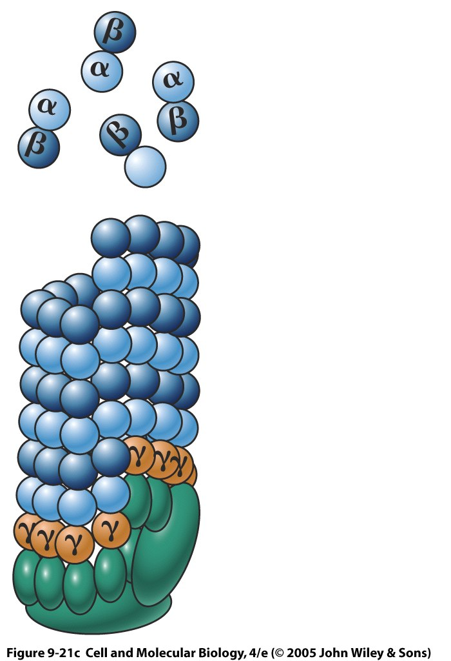

Slide 11
F. MICROTUBULE DYNAMICS:
Key points- the cap means that subunits are added easily- loss of GTP = harder to add subunits, need higher subunit conc. to add.
Produces microtubule catastrophes!

Slide 12
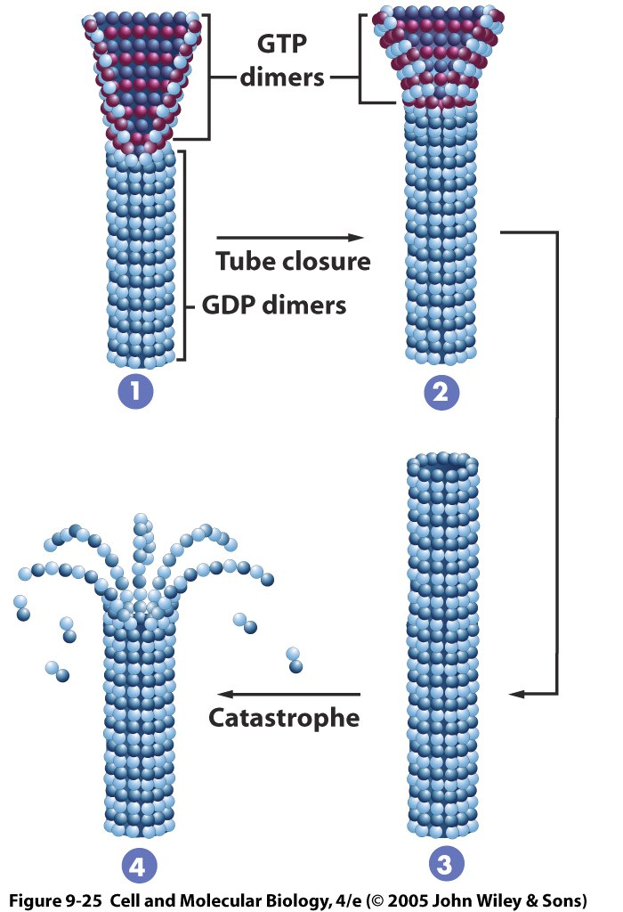
W/ cap- slowly growing; w/o- rapidly shrinking- MT catastrophe!

Slide 13
MT drugs
Colchicine- prevents MT formation- arrests cells at metaphase
Taxol-Stabilizes MT’s – cancer drug
Useful in determining role of MT’s in a process

Slide 14
Intermediate filaments
10 nm in diameter
Only in animals! (??plant/fungal nucleus??)
Variety of types- 60 genes!
Seem to be involved in providing strength to cells.
Able to interact with both MT's and microfilaments (actin filaments).

Slide 15
Some types to remember
Keratin- epithelial cells, hair, nails
Neurofilaments- in, well, nerves
Lamins- lines the nucleus

Slide 16
Microfilaments (Actin)
Where we’re going:
Basic structure, polarity, treadmilling
It’s good buddy, myosin, w/ all its types
Muscle contraction
Amoeboid movement

Slide 17
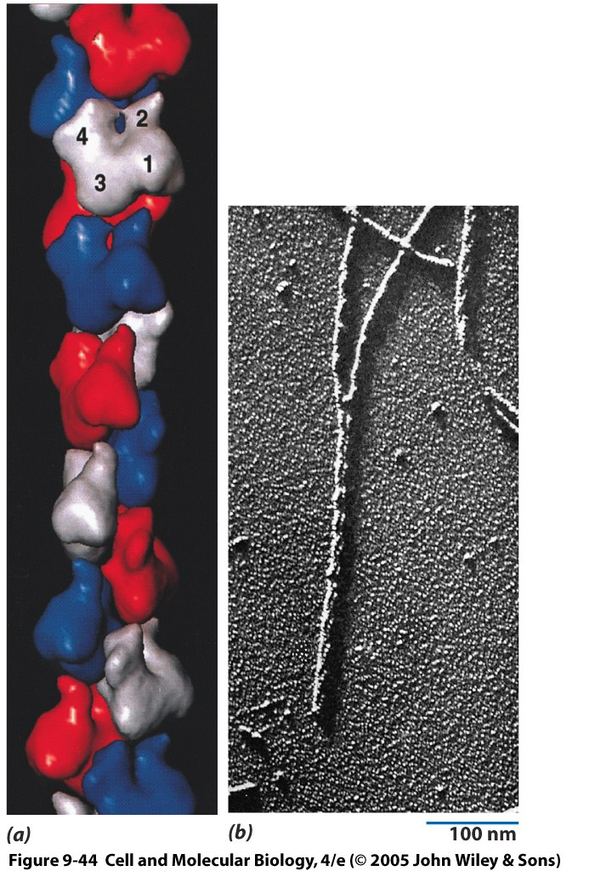
Minus end
ATP binding cleft
Domains 1-4
Subunits= G actin-bound w/ATP; F-actin= microfilaments
Looks like a double helix!

Slide 18
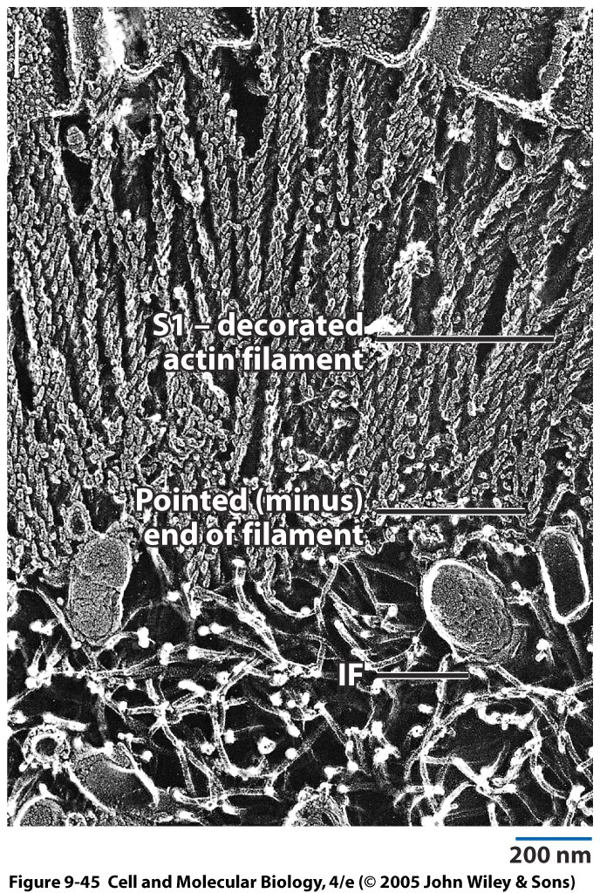
S1 is a myosin fragment that binds to actin- the points point to the minus end

Slide 19
Poisons!
CytochalasinB-depolymerizes
Phalloidin- stabilizes. The Amanita mushroom has TWO nasty toxins that cell biologists like. We’ll meet alpha amanitin later.

Slide 20
Muscle Contraction
Three types of muscle fibers:
Skeletal, striated, voluntary
Heart- more like skeletal, but not multinucleated. Its structure allows the propagation of an action potential (the heart beats by itself, w/o outside signals)
Involuntary, smooth muscle- gut, uterus, etc.

Slide 21
Things to know
Three major cytoskeletal components
Major stories- cilia movement, muscle contraction, amoeboid movement
Major motor proteins for both MT and actin, major poisons
Structure of the ends of MT’s and actin
Accessory proteins that we’ve mentioned.

